Slide 1
Remote Material Classification Using a Laser Module and LSTM Deep Learning Algorithms
Yusuf Soyçeken - 20290497

Slide 2
Table of Contents
Review of the Project
The milestones of the Project & Why they are important
Schedule
References

Slide 3
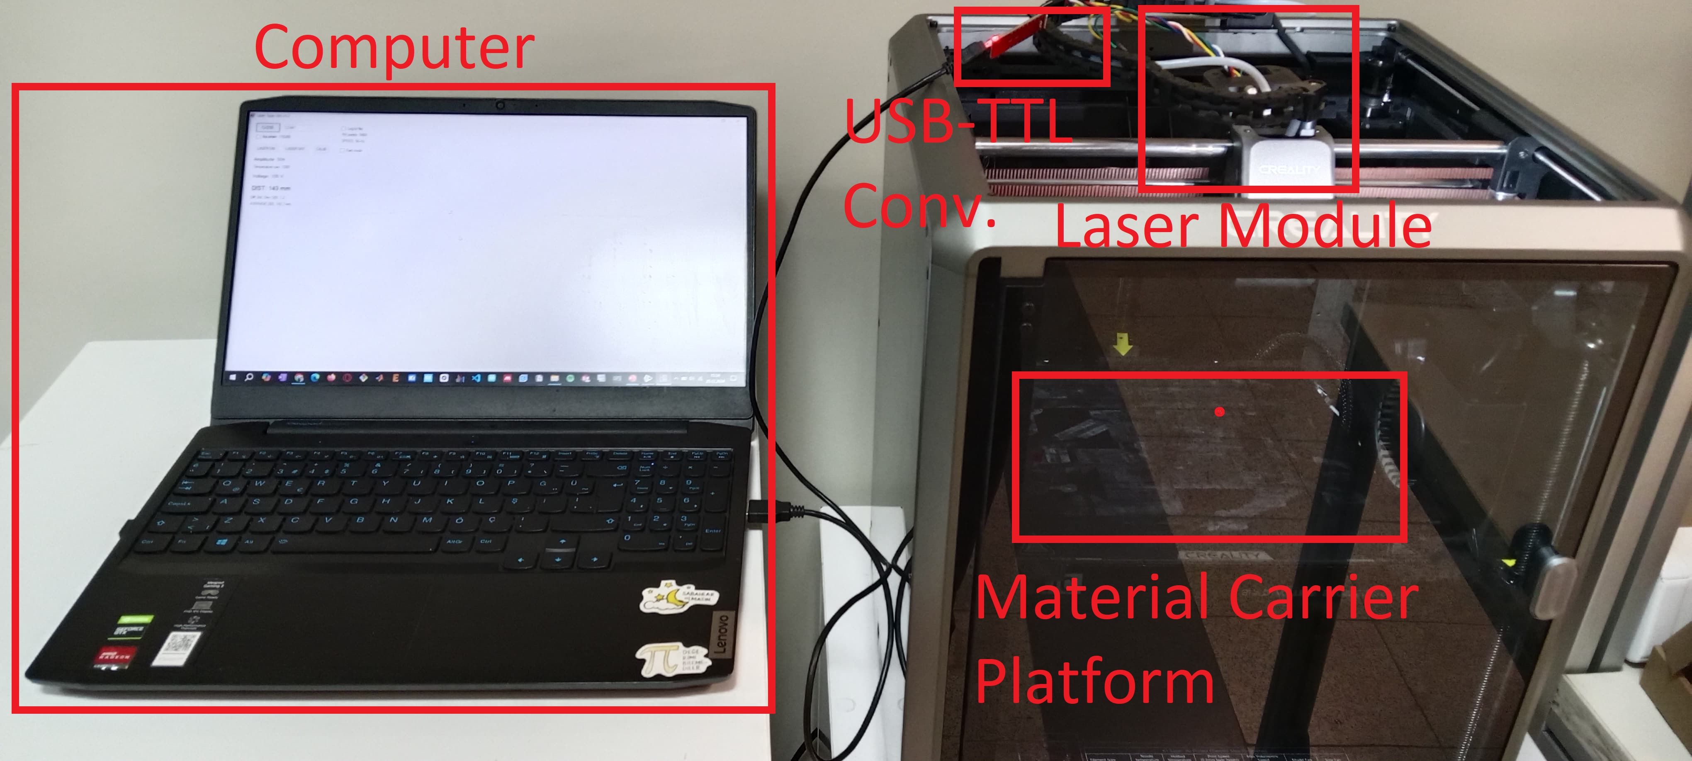
Review of the Project
In the previous semester, data acqusion system was designed built and tested.
6 PLA samples, consisting of 3 different colors and 2 different shapes, along with 2 paper samples of different colors, were analyzed at 36 different points on each sample.
Sampling Setup

Slide 4
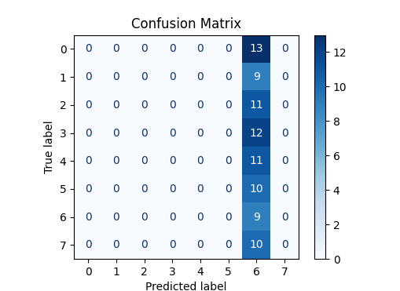
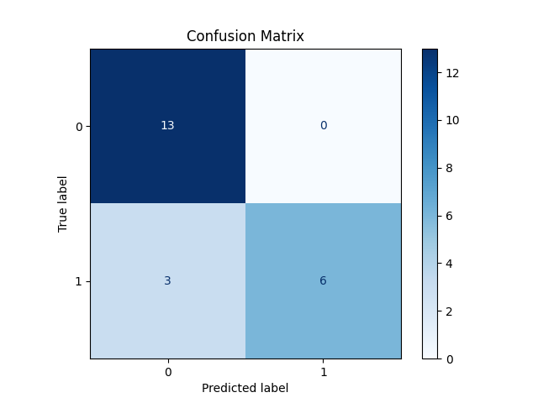
Review of the Project
The classification method was not sufficient to classify materials all the materials.
However, it is very promissing to classify two different material.
Classification by using LSTM applied after application of Welch’s Method.
Confusion matrix of classification of 8 different sample (Accuracy %8.77)
Confusion matrix of classification of 2 different sample (Accuracy %86.36)

Slide 5
The milestones of the Project & Why they are important i.Schedule
Development of a new data acquisition device (2 Weeks)
Literature review (4 Weeks)
Seaching for new and releated articles (1 Week)
Comperation of usage of CNN and LSTM (3 Weeks)
Sample and dataset preparation (1 Weeks)
Pre-processing techniques (3 Weeks)
Yule-Walker AR Method
Wavelets
Dataset Visualization (1 Week)
t-SNE, UMAP
Classification (3 Weeks)

Slide 6
The milestones of the Project & Why they are important
Development of a new data acquisition device (2 Weeks)
After tests on a 3D printer as a cartesian robot by manipulating GCODE of the printer some issues occured:
Extruder, heatbed and fans of the printer cannot be shut down completely. 3D printer always starts with heating its bed and nozzle, it also controls the fan. It might cause error due to the change of the temperature of the sensor and static charge circulation due to the fans.
GCODE and sampling program works with delay because of the lack of I/O port on a commercial 3D printer. The synchronisation can be only achieve by starting the programs at the same time.
There are no measurable significant change on the signal while changing the distance of the sample in a 25cm range. The sensor can give different results while measuring samples at meter scale distance. It could not be observed, because Z-axis of a 3D printer is limited.

Slide 7
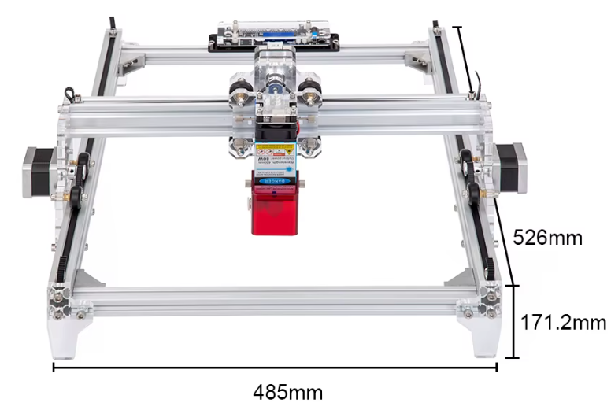
The milestones of the Project & Why they are important
Development of a new data acquisition device (2 Weeks)
A 2-axis cartesian platform with a Arduino based microcontroller will be used as a new sampling device.
The laser can be moved on horizontally and vertically.
The laser can be placed at the desired measurement distance
Laser can be moved and controlled synchronously by programming the microcontroller.
2-axis cartesian laser cutter

Slide 8
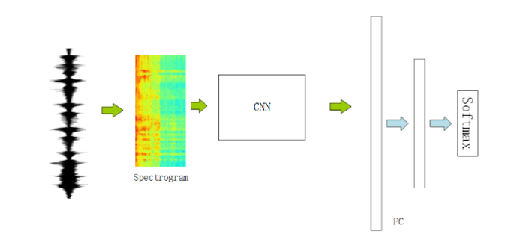
The milestones of the Project & Why they are important
Literature review (4 Weeks)
Starting the new semester with a quick literature search. (1 Week)
Classifying a spectogram can be also achieved by visual representation of a spectrogram and Convolutional Neural Network (CNN)
LSTM and CNN are going to be compared with a ready to use dataset.[1] (3 Weeks)
This is an important milestone before dataset preparation process
Classifying audio signals by CNN [1]

Slide 9
The milestones of the Project & Why they are important
Sample and dataset preparation (1 Weeks)
This milestone is basically preparation of samples and data acquision process.
Creating a dataset that consists of 8 sample with 36 different point (288 time series, each time series consists of 4000 sample) takes 13 hours.
Increasing the number of material type and sample is going to require longer time to create dataset.

Slide 10
The milestones of the Project & Why they are important
Sample and dataset preparation (1 Weeks)
The materials from daily life are going to be classified. These materials will be placed on a stand in front of the sampling device.
Aluminium
Steel
Iron
Glass
Frosted Glass
Wood
PLA (At least 2 colour)
PETG (At least 2 colour)
White TPU
Black Fabric
White Fabric
Red Fabric
Concrete block

Slide 11
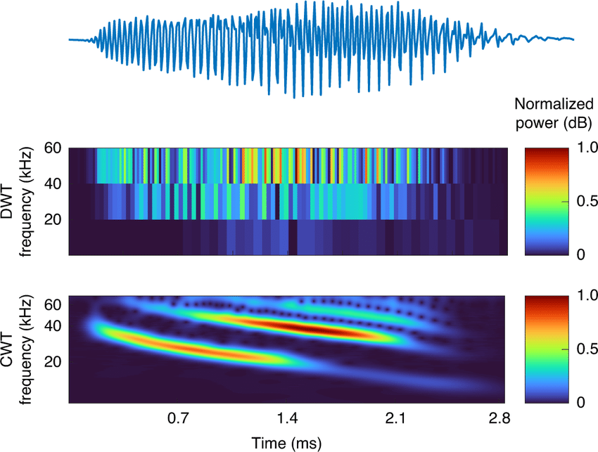
The milestones of the Project & Why they are important
Pre-processing techniques (3 Weeks)
Only subtraction of the environmental noise and Welch’s Method was applied in the Project-I phase
Welch’s Method provides information about low-frequency component of the signal.
Multiple pre-processing technique can be applied to extract the distinct features of the signal:
Yule-Walker AR Method
Provides information about higher frequency components
Wavelets
Gives time and frequency information at a given instance with lower resolution in time or frequency.
Result gives a 3D surface of Time-Frequency-Amplitude
Discrite and Continuous Wavelets Transform [2]

Slide 12
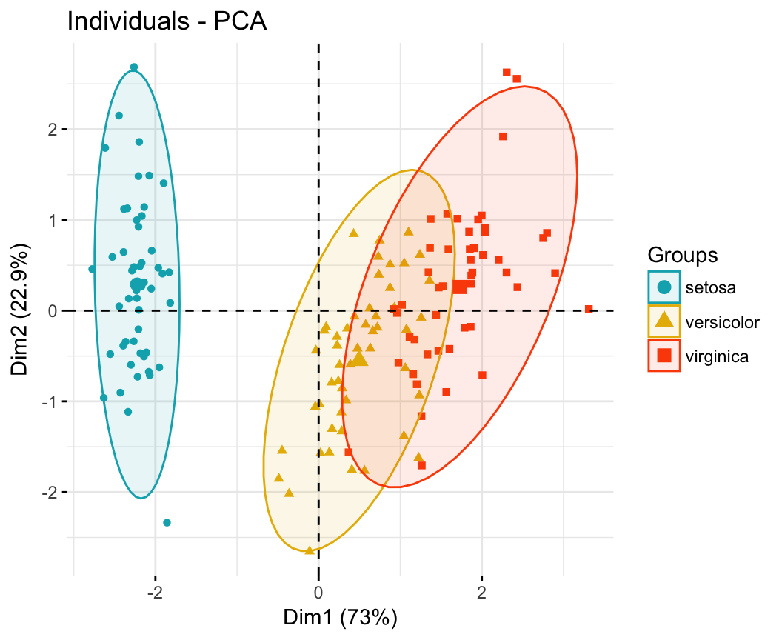
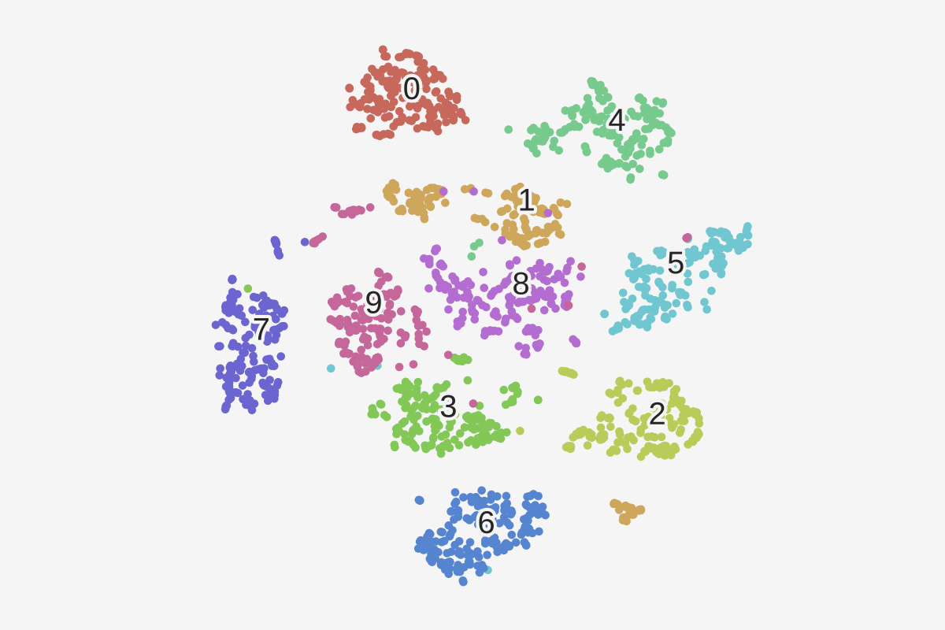
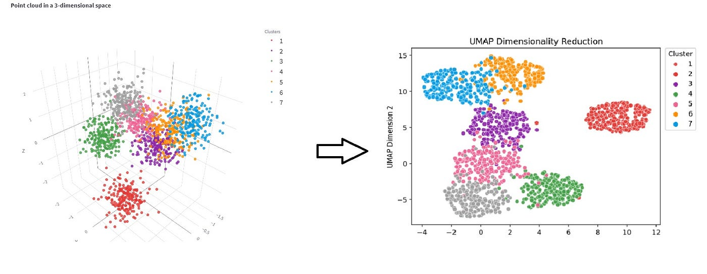
The milestones of the Project & Why they are important
Dataset Visualization (1 Weeks)
Before classifying materials dataset is going to be obtained to determine wheter it is convinient to classify.
Dataset visualization can be achieved by reducing of the dimention of the dataset into 1D, 2D or 3D.
Principal Component Analysis (PCA) can be used for a linearly correlated dataset.
t-SNE (t-distributed Stochastic Neighbor Embedding), Unifrom Manifold Approximation and Projection (UMAP) for non-linear correlated dataset.
PCA, t-SEN, UMAP example respectively

Slide 13
The milestones of the Project & Why they are important
Classification (3 Weeks)
Final study of the project
The final classifier model depends on ‘’literature review’’ milestone
The result will show the accuracy of the model on a confusion matrix

Slide 14
Referances for this presentation
[1] christianlillelund. “Classify MNIST Audio Using Spectrograms/Keras CNN.” Kaggle.com, Kaggle, 12 Dec. 2020, www.kaggle.com/code/christianlillelund/classify-mnist-audio-using-spectrograms-keras-cnn/notebook. Accessed 19 Feb. 2025.
[2] Arts, Lukas P. A., and Egon L. van den Broek. “The Fast Continuous Wavelet Transformation (FCWT) for Real-Time, High-Quality, Noise-Resistant Time–Frequency Analysis.” Nature Computational Science, vol. 2, no. 1, 1 Jan. 2022, pp. 47–58, www.nature.com/articles/s43588-021-00183-z, https://doi.org/10.1038/s43588-021-00183-z. Accessed 20 Dec. 2022.

